Slide 1
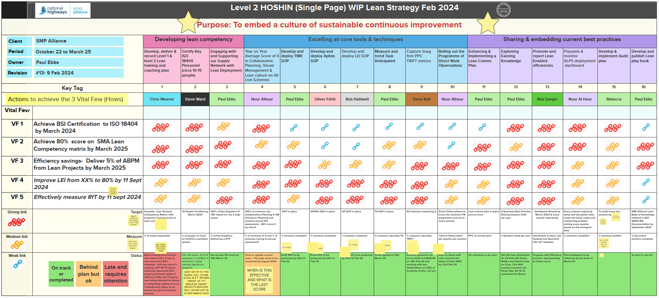
Clarity of Roadmap & Lean Concepts
Single Page Lean Strategy
Notes:
PE
92 pages to 1
Our purpose
What’s
3 areas of how’s and will expand on these through the ppt
Audits, lean manual and cohorts

